Slide 1


Inclusive Markets Project
Bolivia

Slide 2
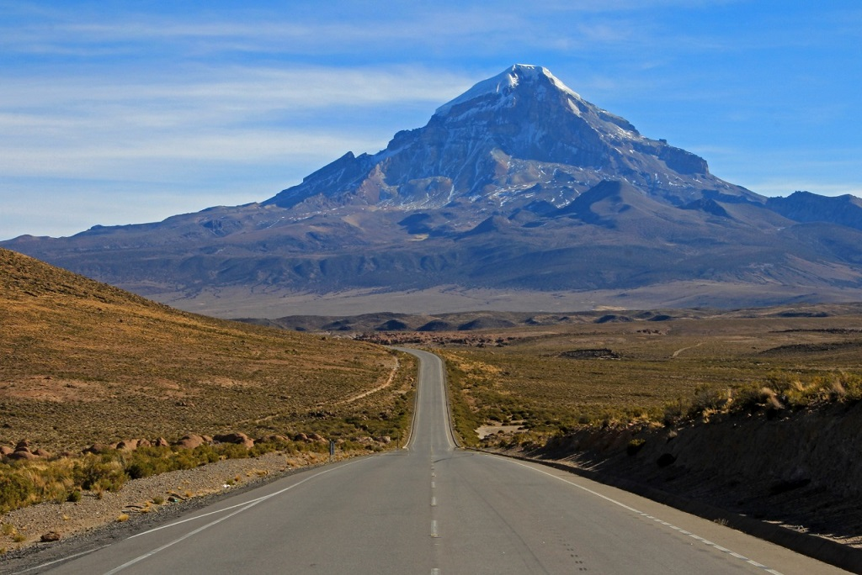
A journey through the project
Climate change
Topics
Areas and Products
Social Inclusion
Overview

Slide 3


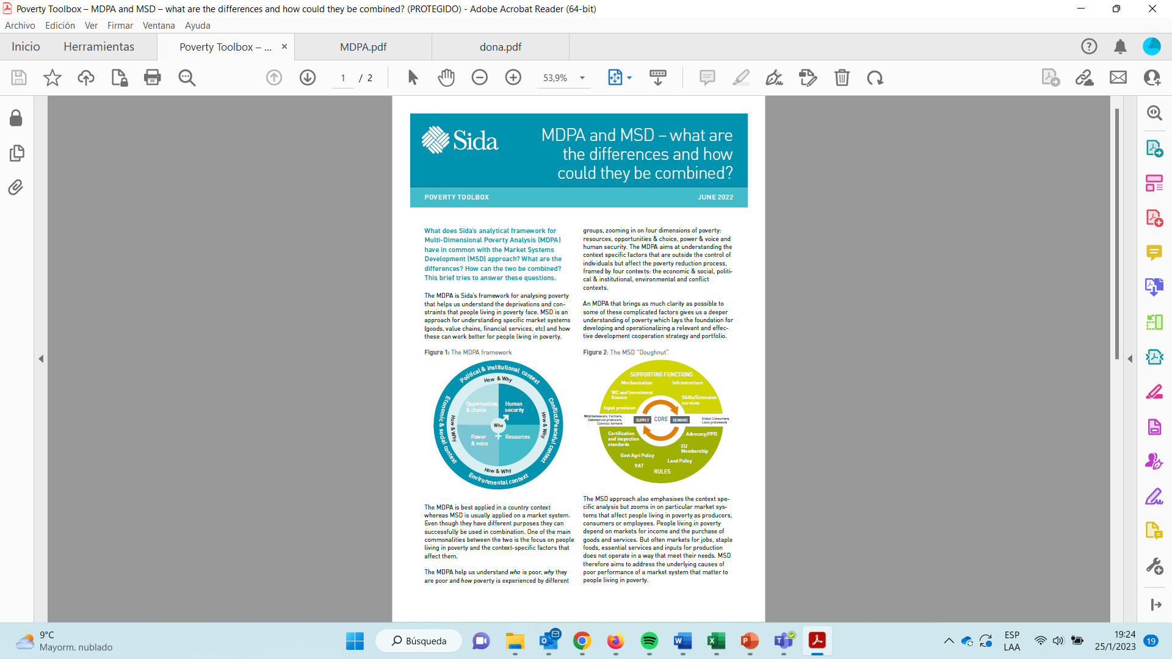

Overview
Approaches
Target Group
Intervention Group
IMSD + MDPA
Vulnerable men and women of rural / periurban areas engaged in agrifood system
Private, Public and academic actors
Local, Regional, National and International

Slide 4
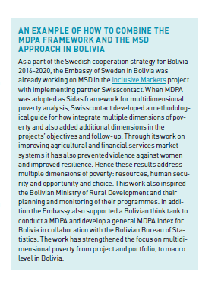

https://cdn.sida.se/app/uploads/2022/06/21094118/10206294_Sida_Poverty_Toolbox_MDPA_and_MSD_webb.pdf

Slide 5

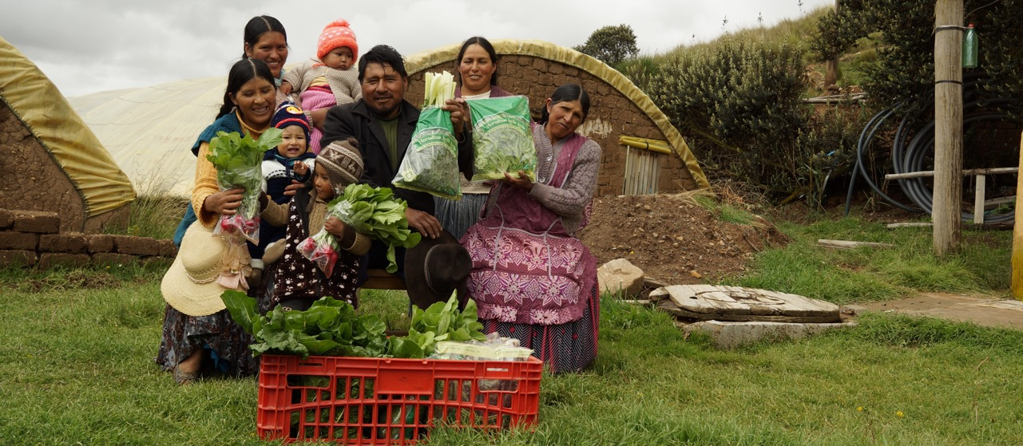





Target group
Income
At least 50% comes from agrifood production
Workforce
Family labour
Seasonal paid or salaried labour
Self consumption
Aprox 80% of family production for the local market
Gender gaps
69% difference in income
60% of women identify discriminatory acts and disagreement with women's participation

Slide 6




Partners & Allies
Leverage
INTERNATIONAL LEVEL
NATIONAL LEVEL
Ministry of the Presidency
FAM
Ministry of Agriculture
Ministry of Education
SEA
58%
42%
MMAyA
SENASAG
ENR
CADEX
SENARI
INIAF
IPDSA
MDPyEP
SEDEM
Bolivian Association of Supermarkets
REGIONAL LEVEL
BDP
SEDERI
Departmental Governments
CABOLQUI
APS
PRODEM
UCB
ASFI
UNIVIDA
LOCAL LEVEL
UMSA
FIE
Alternative Education Centres
USFX
ASOBAN
BIOTOP
SLIM
UTO
Exporting companies and associations
ECOFUTURO
Women’s Association
University Siglo XX
NACIONAL VIDA
Rural Locations
Producers’ Association
Municipal Governments
UGRM
BIOTOP
National Social and Public Platform for Care work
PROINPA
Farm stores
UATF
Entrepreneurial leaders
Experimental Centres
CIFEMA
UMSS
PRIVATE
PUBLIC
ACADEMIC

Slide 7


Topics (example)
SUPPORTING FUNCTIONS
WV and Investment finance
Last mile in Bolivia
Infrastructure
Mechanisation
Input provision
Skills/Extension services
First mile in Europe
Inputs
Primary Production
Transformation
Local market
Export
Import
Certification
and standards
RULES
Advocacy/PPD
Gov Agri Policy
Land Policy

Slide 8
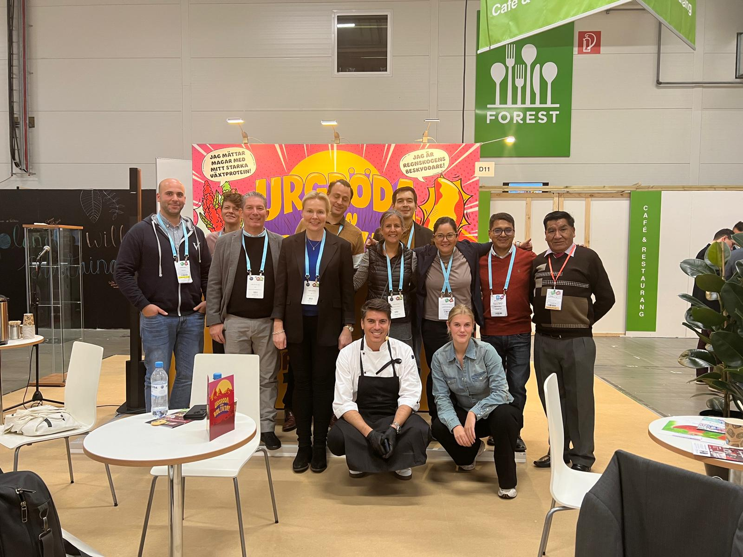
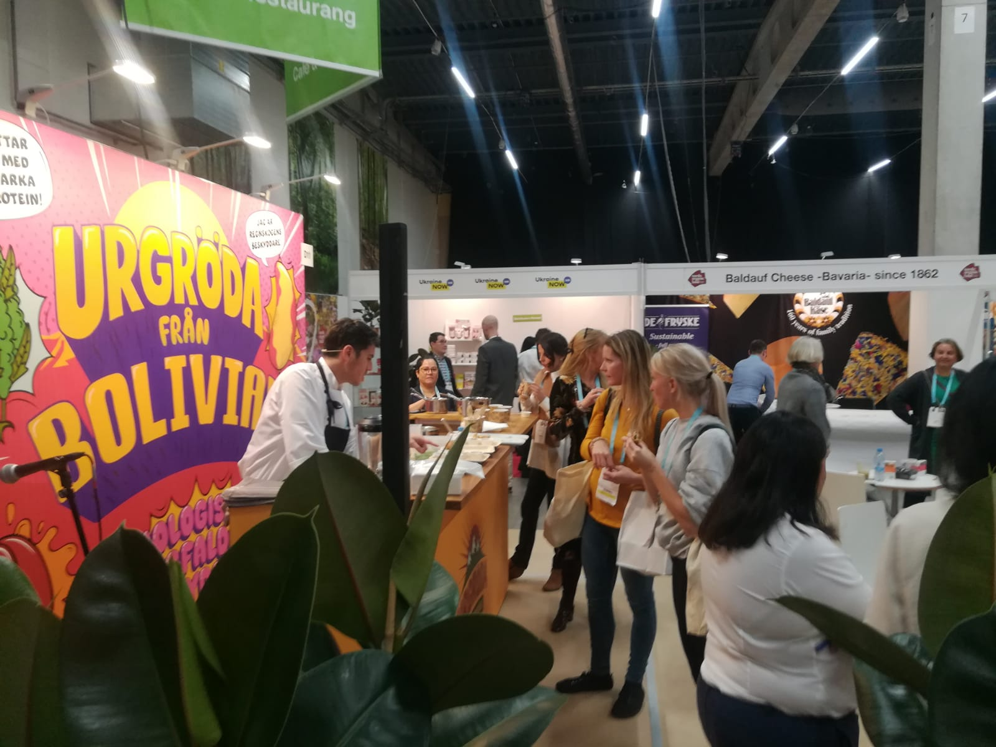
https://www.swisscontact.org/es/noticias/la-agricultura-familiar-presente-en-la-feria-de-malmo-en-suecia

Slide 9
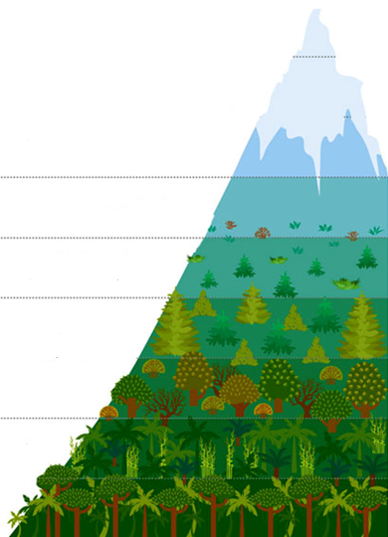
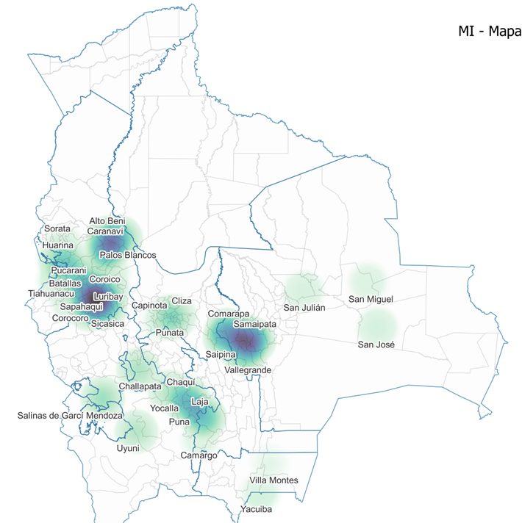
Areas and Products
Potato
Andean grains
Dairy
Highlands
4.200 mbls
Vegetables
Fruits
Valleys
3.100 mbls
Potato
Vegetables
Fruits
Mesothermal valleys
1.500 mbls
Oilseeds or grains
Cacao
Cofee
Amazon fruits
Lawlands
300 mbls

Slide 10
Climate change and sustainable production
Decrease use of chemical inputs
Δ Fertiliser imports 39,000 (t) 2006 to 80,000 t in 2019.
2% of chemical pesticides highly hazardous and 43% moderately hazardous
Regenerative agriculture
35% of degraded agricultural land
Valorization of forest resources
3rd most deforested country (tropical deforestation)
6.11 million hectares of forest lost, 10% of its tree cover since 2000.
Increased rational use of water
6 months of water deficit per year
Only 11% of total cultivated area under irrigation
Notes:
ESTADO PLURINACIONAL DE BOLIVIA MINISTERIO DE MEDIO AMBIENTE Y AGUA

Slide 11





Social Inclusion
Gender-Based Violence
Digital Divides
74.7% of women have experienced some form of violence in their lives.
44% have suffered aggression from their partner
35% women do not know how to use a smart mobile phone. Men 24%
40% women do not know how to use the internet Men 33%*
Financial Literacy
Microinsurance
80% of women have no access to credit and the gap with men is 36%.
Vulnerable group to risks: accidents, illness, death and natural disasters lose all their capital.
* Averages in Latin America 2020
Notes:
90% of rural households and do not have an internet connection

Slide 12
Results (2018 – 2021)
31.000
27.814
Families benefited from services provided by the project.
55% Women
Women and men to improve the working conditions (self-employment
13.000
211%
Families increased their net income
Increase on average in net profit
206 USD/year
10,702
41%
families have improved their climate change adaptation strategies
Increase in the number of women treated for gender-based violence

